Slide 1
Marjori Godlin Roemer "Which Reader's Response"

Slide 2
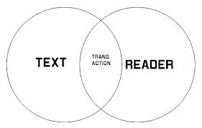
Reader Response Theory Defined

Slide 4
“Reader-response theory is a gesture toward opening up dialogue with students and problematizing questions of authority, but it can only be a significant gesture when appropriated by teachers who recognize the forces against which such freedom must contend” (920)
Roemer's Argument

Slide 5
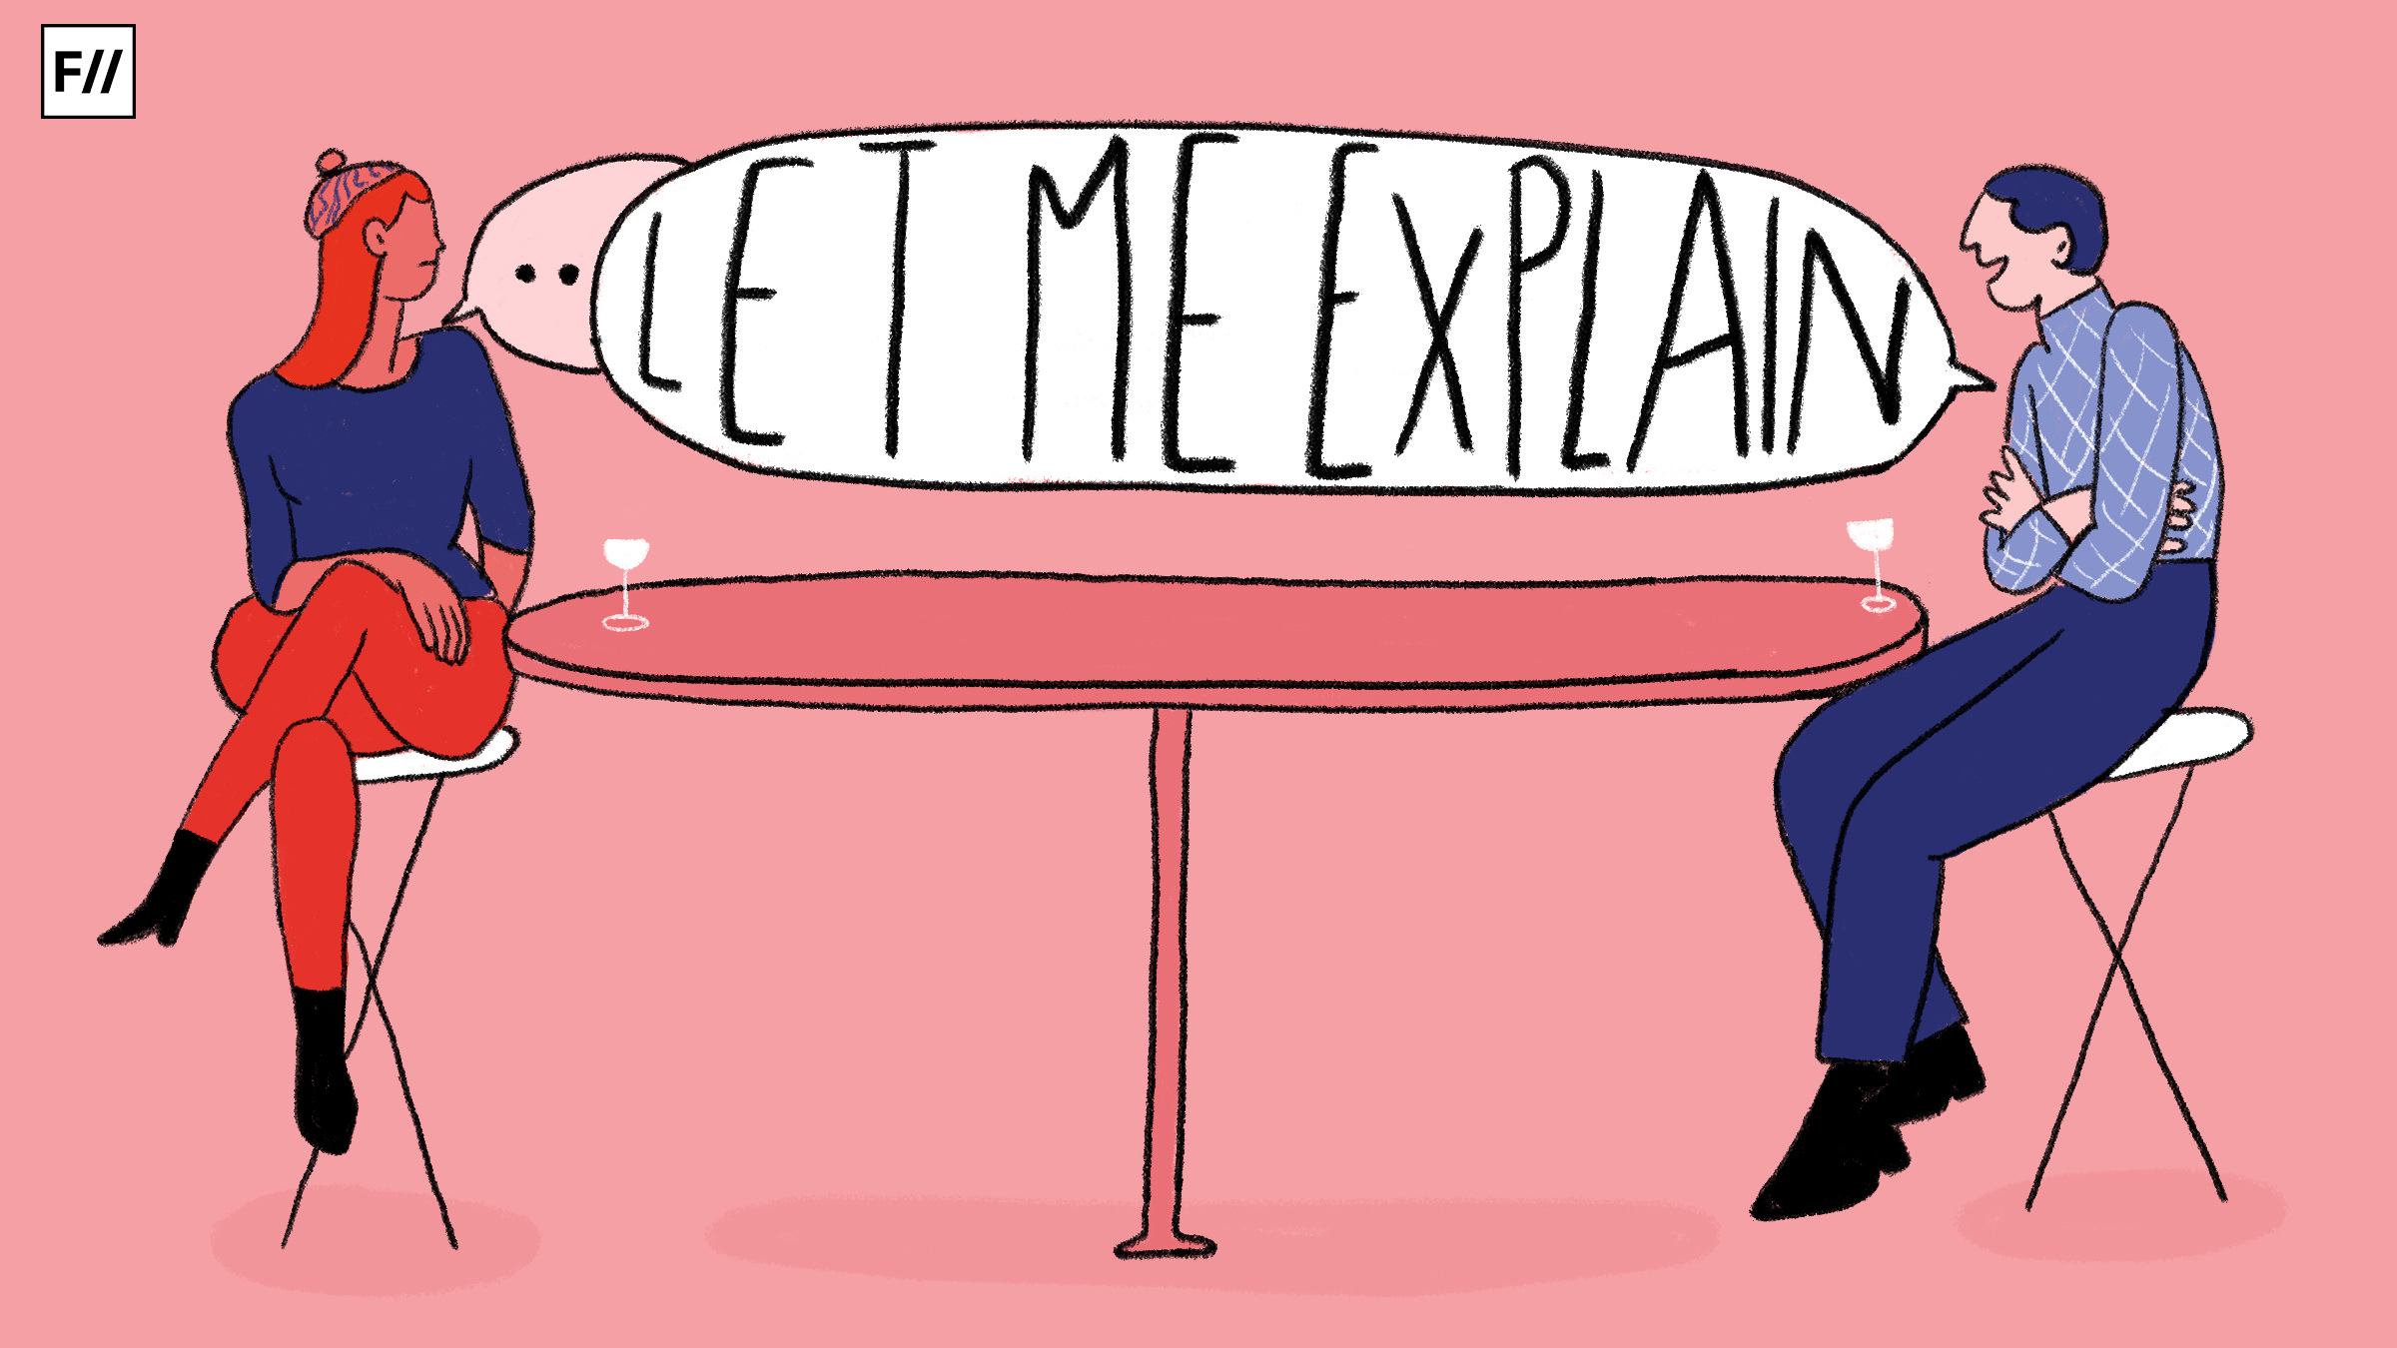

Slide 7
" It is difficult to invest any degree of honesty or integrity in what is perceived as a huge, faceless bureaucracy that processes you from kindergarten through law degree and at various stages lets you through or knocks you out according to its own will. Most of the students I meet cannot even imagine using their educations for their own purposes" (920)

Slide 8
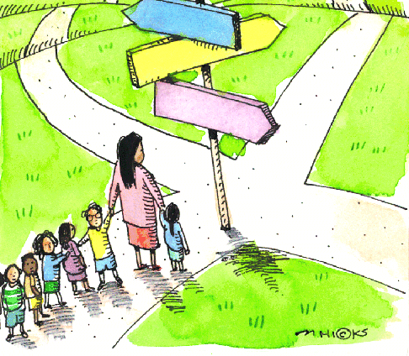

Slide 9
What is critical here is that silencing, and marginalizing do not educate; they alienate instead… To have the ability to effect change in minds, we have to be able to interact with minds and, ideally, to allow the various minds before us to interact honestly with one another (916)

Slide 11
Poetry In Connection With the Reader Response Method

Slide 12
Why do people hate poetry?

Slide 13
World of the Future, We Thirsted
"Straws, plastic caps, crushed cans,
in a three-block walk you could fill a sack.
As if we could replenish spirits quickly,
pitching containers without remorse —who did we imagine would pick them up?"

Slide 14
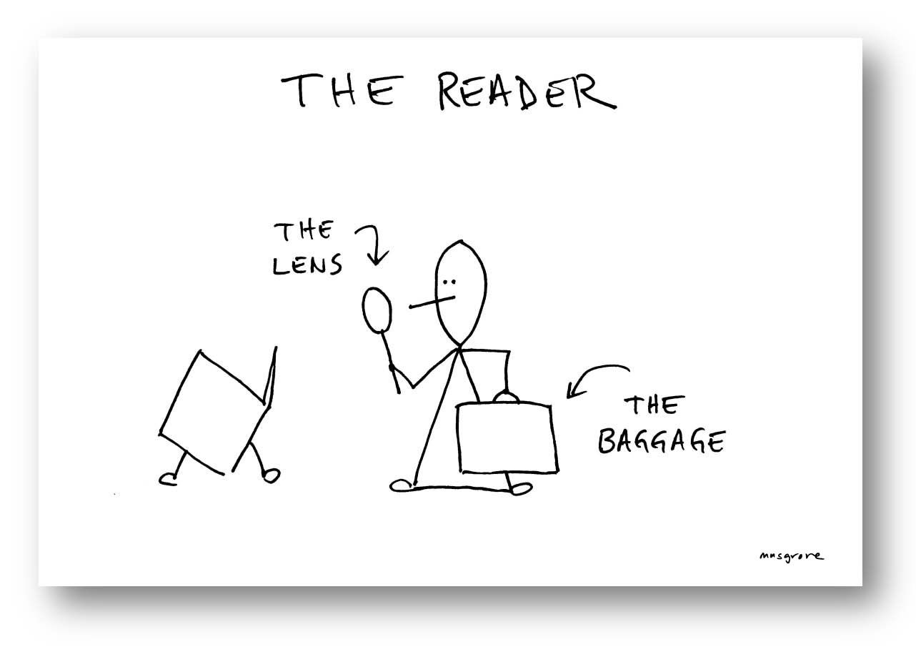
"Social purposes of education = is to reinforce the status quo and the lines demarking privilege, then it is an initiation into the values and manners of the dominant class. As such, it demands that its initiates give up any modes of behavior that conflict with the dominant values. Of course, most of us would prefer not to define our labor in this way. We don't generally view ourselves as apologists for a system or members of a conspiracy to inculcate a specific set of values (917)"

Slide 15
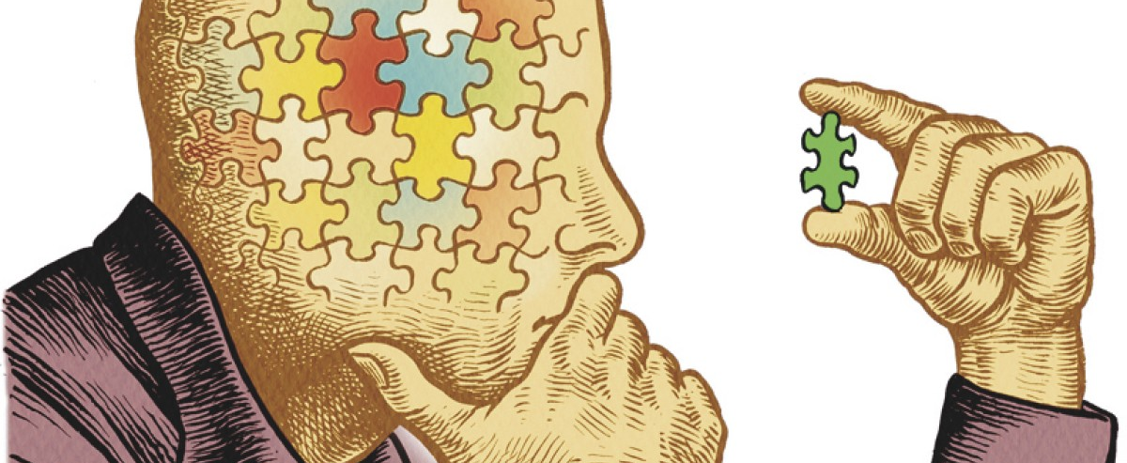
Imagination=The Future

Slide 16
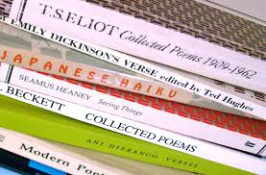
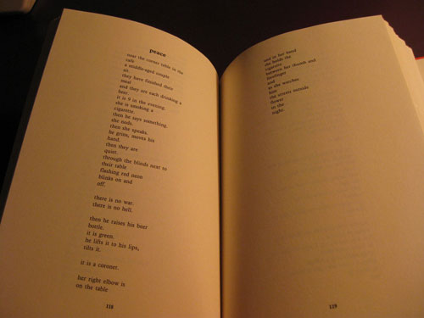

Slide 17
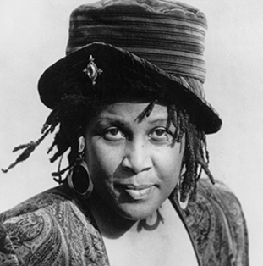

Slide 18
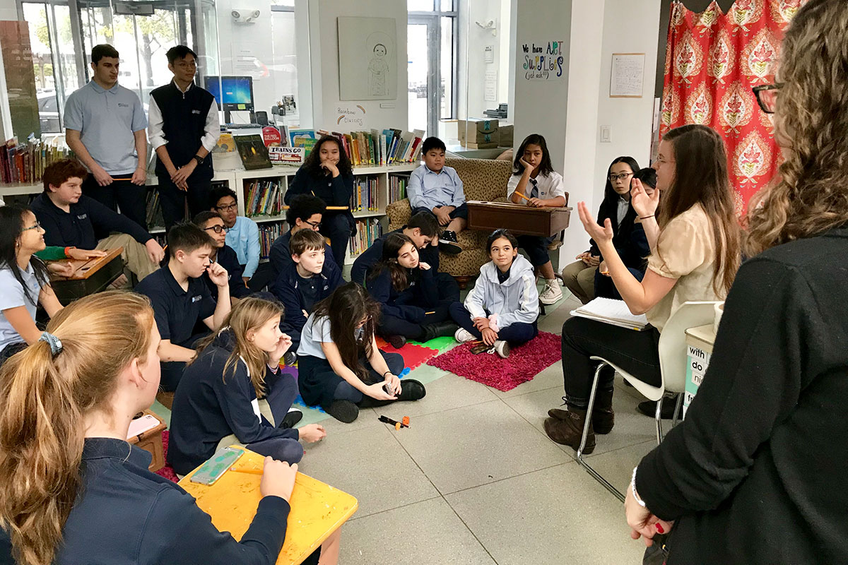
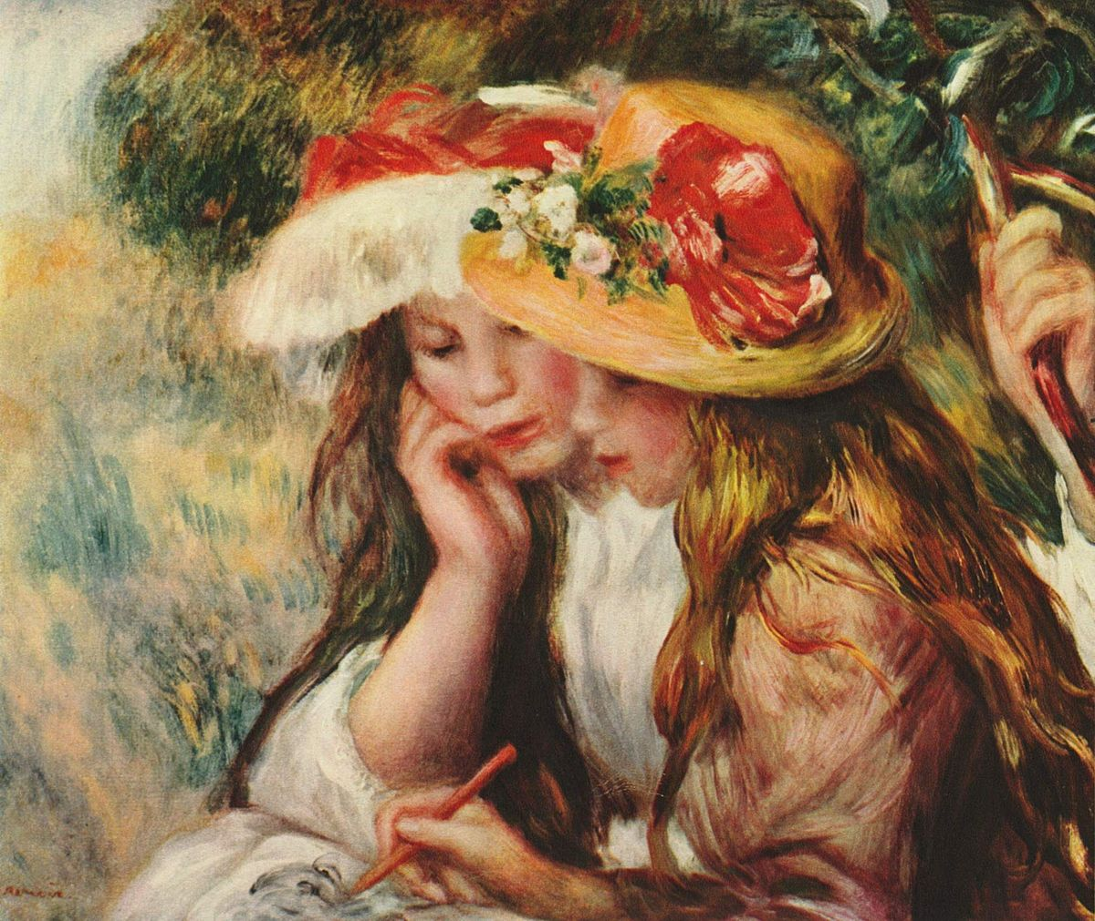

Slide 19
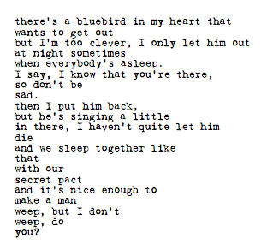

Slide 20
