Slide 1
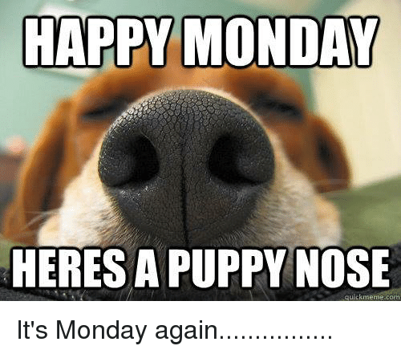
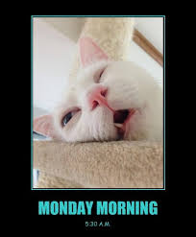
The Monday Update
Welcome to the Monday update with for
3 February 2020
By LTorda

Slide 2
Some highlights from last week. . .
Great work on the Reading Journal/Book Club posts—those who posted anyway.
Really great work on the Teaching Discussion. Genuinely enjoyed reading that.
Still some adjustments to the book club groups due to drop/add shuffle.

Slide 3
“Girl” & “7th Grade”
Gender
Identity Formation
Race
Class
“learned behavior”
Is this literature?

Slide 4
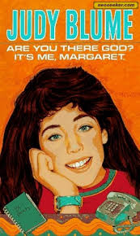
Circling Back to Week One
“The number of Young Adult titles published more than doubled in the decade between 2002 and 2012 — over 10,000 YA books came out in 2012 versus about 4,700 in 2002.”
– The Balance Careers:
Book Publishing
Is YA a genre unto itself?
If so, what defines it?

Slide 5
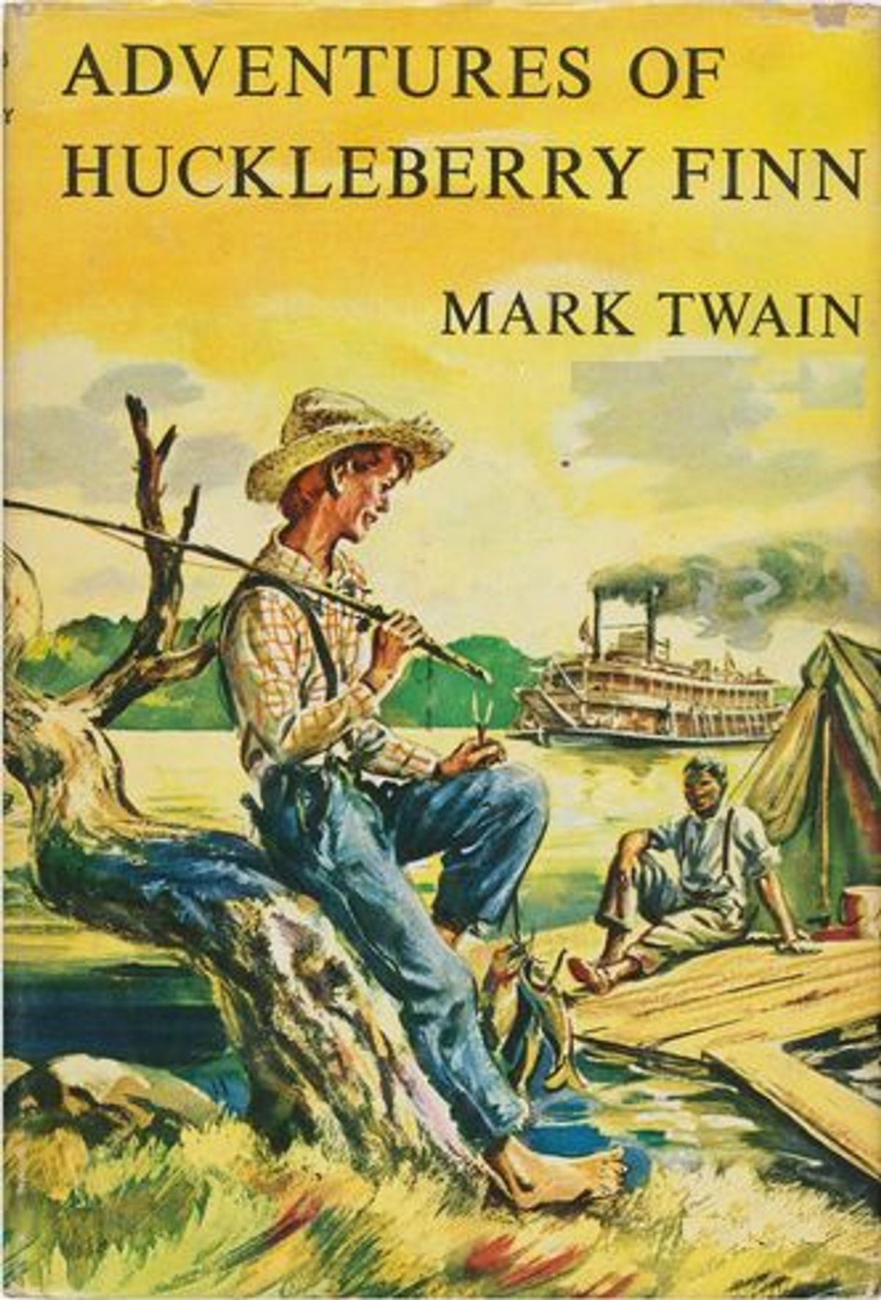
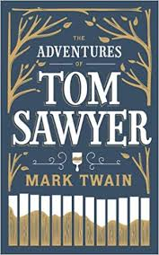
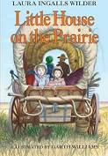
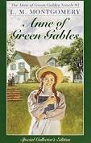
Circling Back to Week One
YA lit is typically some sort of “Coming of Age” story, in the literary sense.
It is Conflict Driven.
The Power of Firsts is a strong influence on YA Lit.
They have elements of Melodrama.

Slide 6
Circling Back to Week One
What is the “Literature”?
What is the “Young”?
What is the “Adult”?
“By some market estimates, nearly 70 percent of all YA titles are purchased by adults between the ages of 18 and 64.”
– The Balance Careers:
Book Publishing

Slide 7
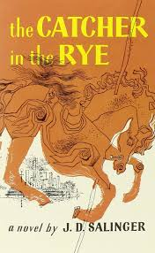
Circling Back to Week One
YA is aware of who YA is for.
Which brings me to my last point, YA is aware that it is a kind of “teaching” text.
. . . So, notice what does NOT appear in our list:
YA novels are simple.
YA novels are easy.
YA novels are straightforward.
Because none of that is what makes YA

Slide 8
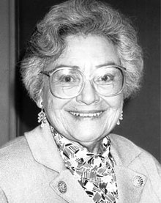
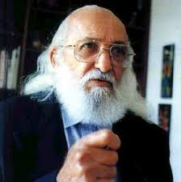
What does it mean to teach YA?
Reading as Meaning Making
Fluency vs Comprehension
Reading word
& World

Slide 9
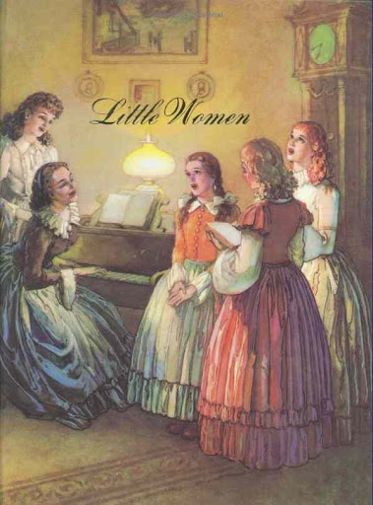
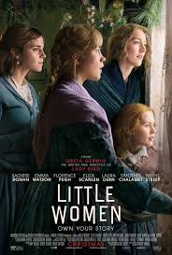
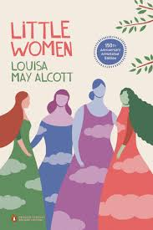
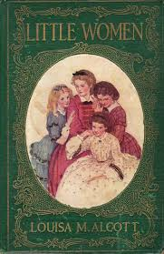
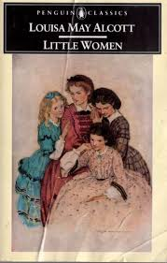
This Week: Little Women
Question for Reading Journal Book Club:
In what ways is this text “young” and “adult” and “literature”? Also, what YA tropes do you see in Little Women that, in your reading experience, you see in recent YA titles?
(yes, I know it’s two questions)

Slide 10
This Week: Little Women
As you respond in your book club Reading Journal:
Don’t forget to consider the scholarly reading for this week (also identified on the syllabus and available for download), “Who Are Your Heroes”

Slide 11
This Week: Little Women
Instead of a Teaching Discussion this week:
On the Class Discussion Board, In 300 words, provide a synopsis of your 2020 version of the classic Little Women. RESPOND in 200 words to at least one of your colleagues by either building on their update idea and/or suggesting why you think, as a reader or a teacher, this would work as an update (or wouldn’t).

Slide 12
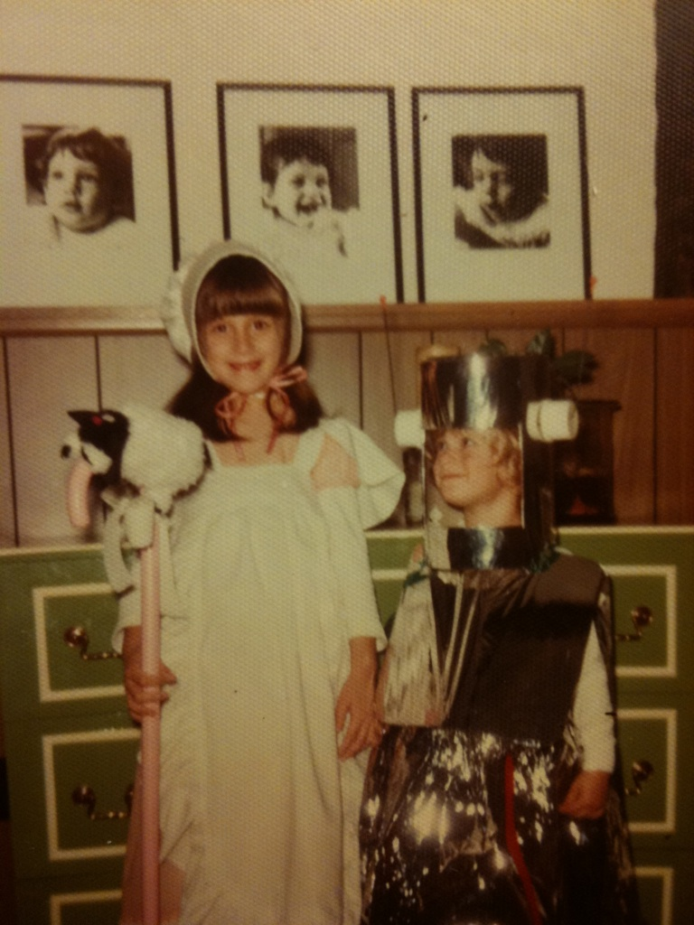
This Week cont’d Flash Memoir: YA Edit
We are all readers before we are teachers
This is worth 10% of your final grade NOT DUE THIS WEEK!!!
Please try not to stress too much and enjoy it NOT DUE THIS WEEK!!!
Read details on the assignment page on our class website. NOT DUE THIS WEEK!!!

Slide 13
This Week cont’d This week’s Q & A discussion board
This week’s Q&A discussion board is live and ready for your questions.
From last week: Trouble-shooting posting to the Discussion Board.

Slide 14
Looking Ahead
What Is a Pecha Kucha?
THIS is a Pecha Kucha.

Slide 15
Take Care of Each Other & Yourselves
The Counseling Center 508.531.1331
The Wellness Center 508.531.1252
The Center for
Multicultural Affairs 508.531.6166
The Campus Food Bank 508.531.2818
The Pride Center 508.531.1408

