Slide 1
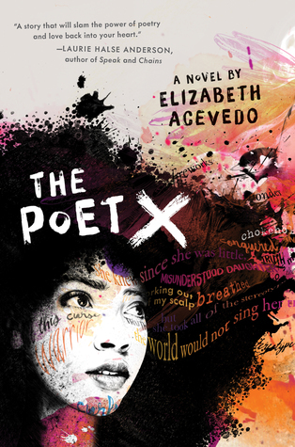
The Monday Update
Elizabeth Acevedo’s The Poet X
(Teaching Discussion Wrap u)p
This Photo by Unknown Author is licensed under CC BY

Slide 2
People who paid attention to the IB curriculum
Jess Rinker talked extensively about the focus of IB on the “global and the personal.”
Nicole Costa stressed the goal of IB to develop “open minded, inquisitive, reflective, and caring” students and global citizens.
Shauna Ridley also picked up on the cultural component of the IB curriculum.

Slide 3
Delight & Instruct or Erudition & Engagement
Ethan Child thought about how one might construct a unit on global poetry--he rightfully pointed out how we often have students write Haikus but don’t talk at all about the history of them or why the 5-7-5 form is essential to how the poem means what it means. An IB curriculum would allow you to explore, for instance, the great Chilean poet Pablo Neruda

Slide 4
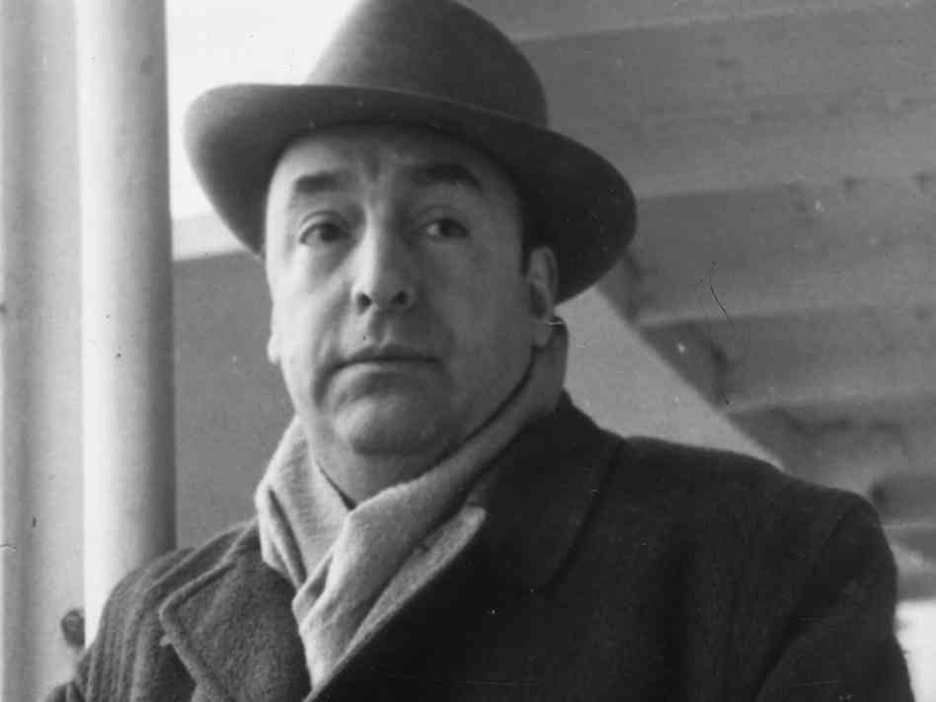
Here is a Sample . . .
Love Sonnet XVII by Pablo Neruda
I do not love you as if you were a salt rose, or topaz
or the arrow of carnations the fire shoots off.
I love you as certain dark things are to be loved,
in secret, between the shadow and the soul.
I love you as the plant that never blooms
but carries in itself the light of hidden flowers;
thanks to your love a certain solid fragrance,
risen from the earth, lives darkly in my body.
I love you without knowing how, or when, or from where.
I love you straightforwardly, without complexities or pride;
So I love you because I know no other way
than this: where I does not exist, nor you,
so close that your hand on my chest is my hand,
so close that your eyes close as I fall asleep.
This Photo by Unknown Author is licensed under CC BY-SA-NC

Slide 5
April is National Poetry Month
Jess posted a link, repeated here to a video that UNESCO posted on World Poetry Day (which would have been the week we returned from our originally scheduled sping break) 21 March 2020. April, the cruelest month according to Chaucer and, certainly, a befitting modifier for this particular April, is also National Poetry Month. It’s a great month to feature poets and poetry of all kinds with students of all ages. The link above to Poets.org has 30 ways to celebrate the month--all of which I highly recommend, particularly if you are homeschooling any young ones this month.

Slide 6
More Erudition
YA should both delight end edify, and, the teaching counterpart to this is engagement and erudition. In other words, we need to develop inquisitiveness and curiosity in students, but we must also educate them, teach them things and teach them how to learn things.
Ethan and Megan Shaughnessy certainly outlined assignments on the erudition ends of the spectrum. They talked about using Acevedo to teach students how to read poetry--they were talking about teaching prosody. I think this is very, very important--both to treat Acevedo as a poet the way we treat Browning and Dickenson and, yes, Shakespeare as poets, and also to teach student to not fear poetry.
Teaching students how to read poetry will help them be better readers, period. Period. I mean it. Period.
Teaching Prosody)

Slide 7
More Erudition
Becky Tynan emphasized and expanded Ethan’s point about teaching speaking skills in the ELA classroom. Speaking skills are in the frameworks (as are listening skills). It’s totally understandable why they might get lost in the myriad things teachers are asked to do in a year, but I like to think of these speaking and listening learning objectives as working in support of the reading and writing.
To that end, many of you, more than I think I can list here (Gabby Sleeper--our own original first responder, Jess, Nicole Costa, Savannah Resendes, etc) were taken with the idea of hosting a Poetry Slam. I appreciated Nicole’s posting of her own work (RETREAT. RETREAT.) talking about what it feels like to present work--any kind of work--in front of an audience.
(Speaking Skills)

Slide 8
Engagement (but sort of erudition too)
This brings me to the “engagement” part of my above formula. That is the other end of the spectrum and it works in two ways here. You could literally never say the word poetry and have things to talk about (Molly Drain, among others, was right to say that this is a book about a lot of issues). Maddie Butkus and I are both big fans of Gabby S’s post-it idea.
(Active Reading)

Slide 9
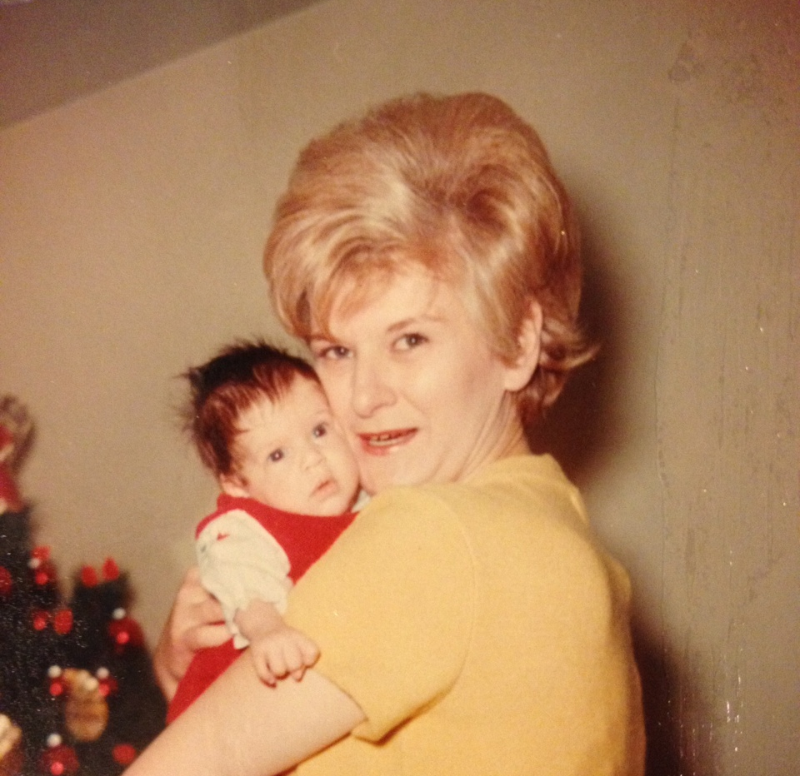

Slide 10
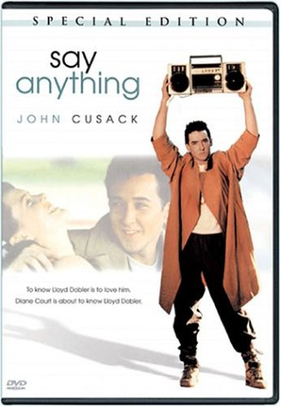
Sam Colon said that she had a “love/hate” relationship to poetry.
And I guess I thought that was more how things were. Because, like, what teenager isn’t secretly writing (pretty terrible) poetry someplace at some point in their life? But maybe I’m wrong. Maybe that’s a Gen X, Dead Poet’s Society, Say Anything sort of a thing.
Whatever you do, don’t tell Ann Brunjes you don’t like poetry. It might possibly kill her. You don’t want that on your conscious.

Slide 11
Engagement (but sort of erudition too)
I think that what Megan and Ethan are talking about teaches students to engage with poetry and learn to not fear it. And I think that some of the deep reading and writing experiences some of you wrote about would help students see that meaning can be made with some effort of any text. Colby Nilsen’s five questions to help students analyze the text. A fair number of you talked about using journals and prompts and small groups--Hannah Brodeur, Gabby, Jess, etc). Several of you talked about this as a bridge text to other poets, including those in the Canon (Becky Tynan had a tidy list). I was super into Nicole Costa’s idea about featuring other women poets.
(Active Reading)

Slide 12
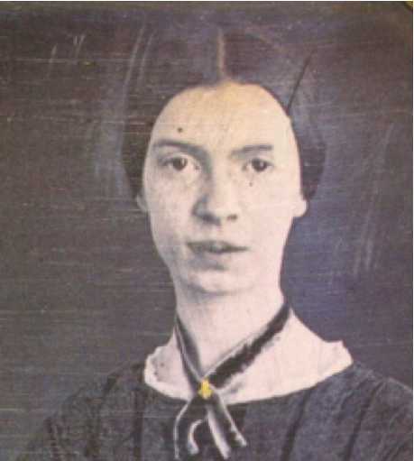
Anybody catch the Emily Dickenson reference? Justin Carpender did.
“Hope” is the thing with feathers - (314)
BY EMILY DICKINSON “Hope” is the thing with feathers - That perches in the soul - And sings the tune without the words - And never stops - at all - And sweetest - in the Gale - is heard - And sore must be the storm - That could abash the little Bird That kept so many warm - I’ve heard it in the chillest land - And on the strangest Sea - Yet - never - in Extremity, It asked a crumb - of me.
This Photo by Unknown Author is licensed under CC BY-NC-ND

Slide 13
Engagement (but sort of erudition too)
This brings me to the “engagement” part of my above formula. That is the other end of the spectrum and it works in two ways here. You could literally never say the word poetry and have things to talk about (Molly Drain, among others, was right to say that this is a book about a lot of issues). Maddie Butkus and I are both big fans of Gabby S’s post-it idea.
(Active Reading)

Slide 14
Engagement leads to learning, but learning can lead to engangement
How fun would it be to have students try to figure out why Xiomara would elect to title one of her own poems the same? I particularly liked how Nicole connected Acevedo to a tradition of women poets because this is a feminist novel. Both Nicole and Justin did a nice job of talking about how one might teach the novel thematically: gender, religion, etc.
And, in keeping with the discussion we’ve been having all semester long, we see how this novel is a coming of age novel, how we have a character trying to figure out who she is in the face of an oppressive authority (her parents, her religion, even her peers in some respects).
One cool thing about this novel is the character of Aman as a role model as a cool, pretty mature, kind model of the kind of young man we want all our young men to grow up to be.

Slide 15
Engagement leads to learning, but learning can lead to engangement
How fun would it be to have students try to figure out why Xiomara would elect to title one of her own poems the same? I particularly liked how Nicole connected Acevedo to a tradition of women poets because this is a feminist novel. Both Nicole and Justin did a nice job of talking about how one might teach the novel thematically: gender, religion, etc.
And, in keeping with the discussion we’ve been having all semester long, we see how this novel is a coming of age novel, how we have a character trying to figure out who she is in the face of an oppressive authority (her parents, her religion, even her peers in some respects).
One cool thing about this novel is the character of Aman as a role model as a cool, pretty mature, kind model of the kind of young man we want all our young men to grow up to be.

Slide 16
Engagement leads to learning, but learning can lead to engangement
So what I’m trying to say here is that the way we make poetry vivid and real for our students is to not be afraid of it and not avoid it, but to embrace it on both the erudition and the engagement end. To involve our students as readers of poetry, but, also, to engage them as writers of poetry.
https://youtu.be/ury9eoLnb-0

Slide 17
Odds and Ends
Savannah Resendes idea about using Ms. Galiano’s assignments is interesting. I like the idea of students doing the “rough draft” and the “final draft” like Xiomara does.
Shauna Ridley and Nicole brought up bringing in music to the class. Music is such a big part of the texts. And, lest we forget, Kendrick Lamar won a Pulitzer Prize last year for Damn.

Slide 18
Representation Matters in every classroom not just majority black and brown classrooms.
The idea of representation came up again this week. And I want to add the same caveat that I’ve been adding all semester long: diversity isn’t just visible diversity. This novel is chock full of universal themes (see my list above: coming of age, discovering who you are, fighting against an authority figure). Yes, it is certainly true that a young Latinx woman reading this novel might find it particularly powerful to read a book about a character who looks like her, and, perhaps even more importantly, by an author that looks like her, but lets not imagine, as I said about Long Way Down, that this novel wouldn’t “fit” in a classroom in Bridgewater/Rayham. We must not reserve black and brown writers for classrooms with majority black and brown students in them.

Slide 19
Odds and Ends
I moved between reading The Poet X and listening to it on audible. It’s read by Acevedo herself, and it’s a powerful experience to hear her reading the English and the Spanish. As I think Ethan, Becky, Nicole, Jess and others were trying to get at is that poetry, like drama, is meant to be spoken. Thus, if I were teaching the class, I would include some of Acevedo reading her work, as she does in this clip.

Slide 20
Odds and Ends
Finally, a number of you commented on the fact that Acevedo (like Jason Reynolds’s Long Way Down) is written in free verse and that that can feel “easier.” But another way to look at poetic form (beyond the haiku) is to look at one of the last poems in the novel “A the New York Citywide Slam.”
That poem is a contrapuntal poem. In essence a contrapuntal poem can be read either across or down (columns). They make sense either way, and they make sense differently. If I was teaching this novel, as much of a challenge it would be, I would ask my students to draft a contrapuntal poem.

